Slide 1


Intro to Bioinformatics
University of Arkansas Workshop 2017
Sept 11-12 2017
Carrie Ganote
Guest starring: Tom Doak, Sheri Sanders,
Bhavya Nalagampalli Papudeshi

Slide 2
Morning Schedule
Intro to NCGAS
Getting Started/Data Management
RNA-Seq Basics
Data Collection 101
Intro to Galaxy
Pop Quiz
Workflows (time permitting) + Lunch

Slide 3
Who is NCGAS?
The National Center for Genome Analysis Support is based in Indiana but caters to a national audience with support from the NSF.
We provide computational resources and support for genomics, transcriptomics, and meta- projects.
Notes:
What is it? -> go over user interface. Where? Diff between local and remote.

Slide 4
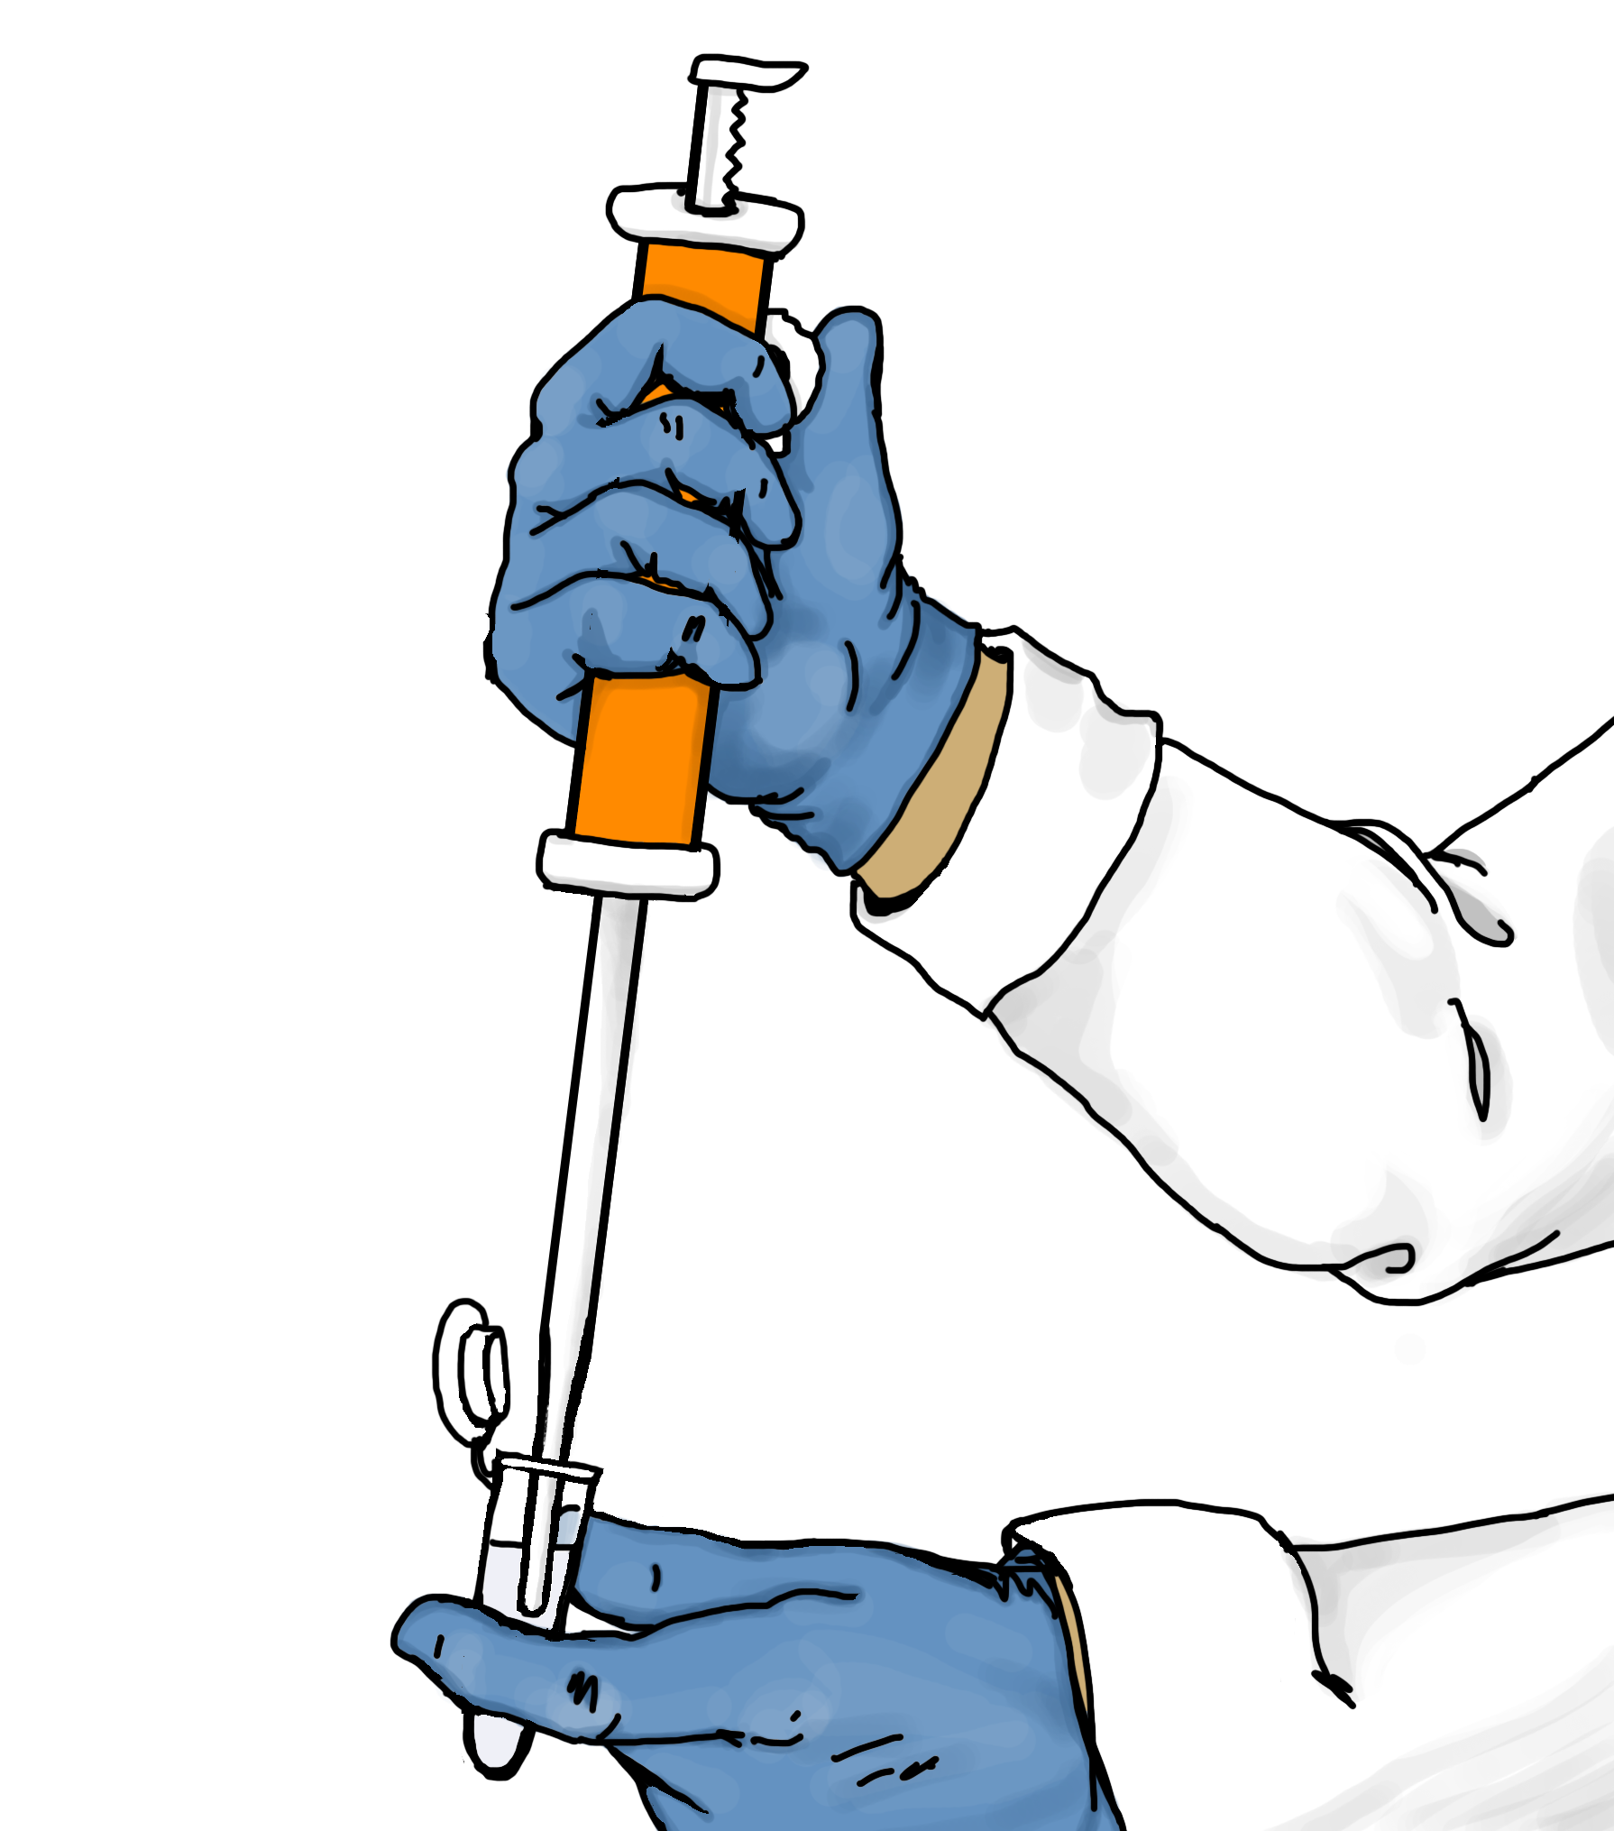
Why are you here?
Computational biology (especially on the command line) can be really daunting, but it can take you from this…
Notes:
What is it? -> go over user interface. Where? Diff between local and remote.

Slide 5
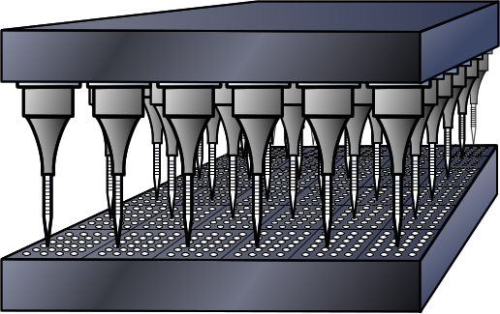
Why are you here?
To this..
Notes:
What is it? -> go over user interface. Where? Diff between local and remote.

Slide 6

Getting
started

Slide 7
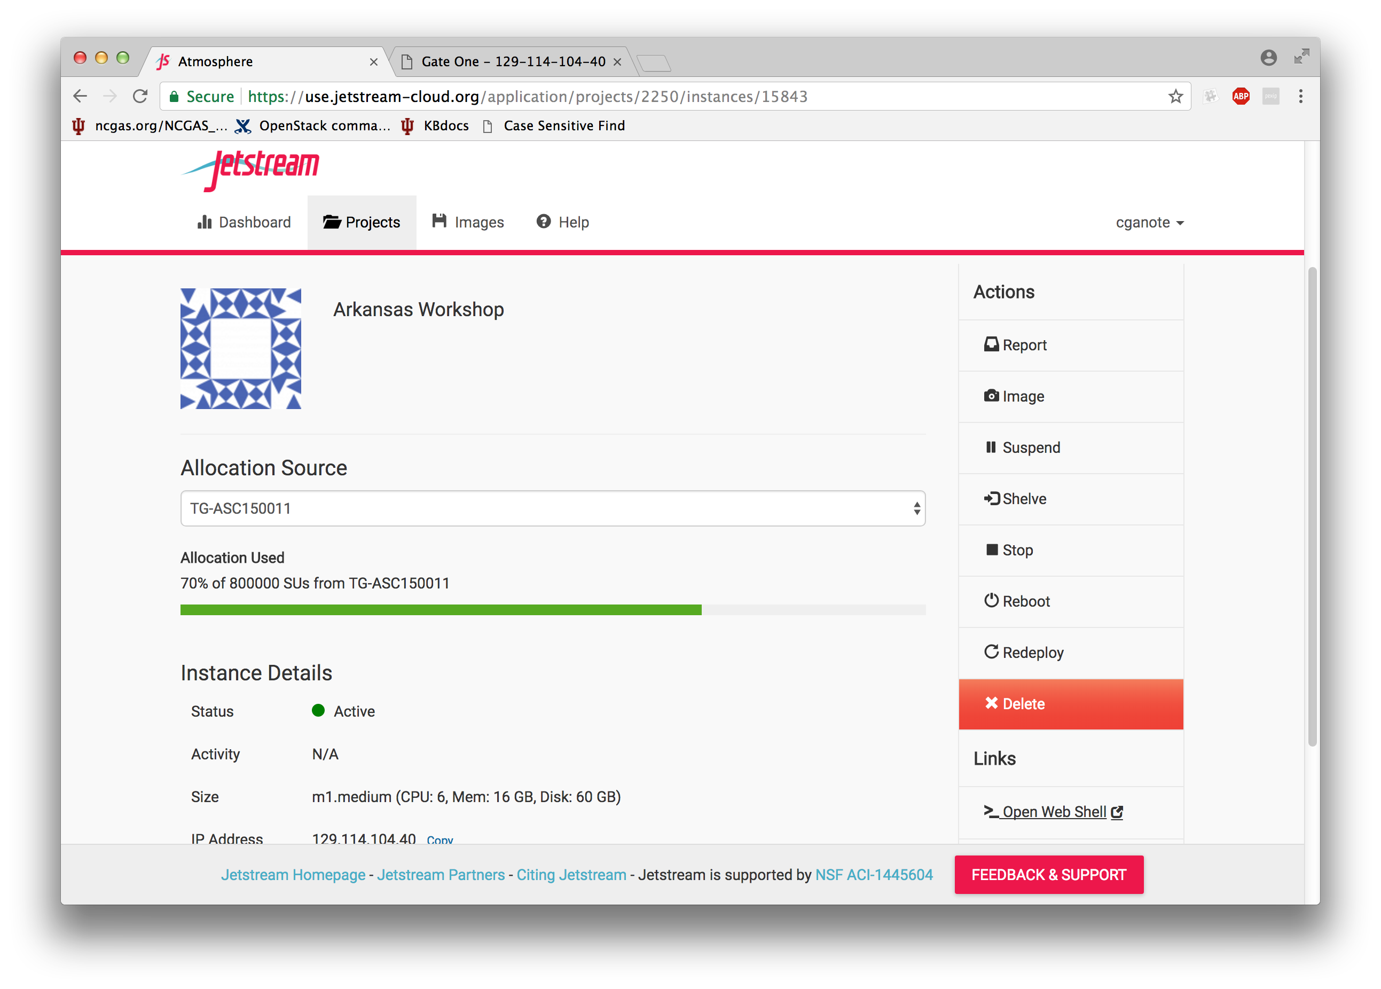
Getting back to your instance
Start up the web shell!

Slide 8
Setting up extra data and environment
cd ~ git clone https://github.com/NCGAS/Ark2017.git chmod -R a+rx . source /opt/galaxy-17.05/paths

Slide 9
Data Management
Data management starts with your
first command. Start by organizing using directory and file structure to your advantage.
mkdir Workshop
cd Workshop
nano README

Slide 10
Data Management
I like to put the date, a small note about what is changing, and an overview of the project, where I got data from, etc
09/12/17 clg
Creating workshop data using Schizosaccaromyces pombe data from ensembl: ftp://ftp.ensemblgenomes.org/pub/current/fungi/fasta/schizosaccharomyces_pombe/cds/

Slide 11
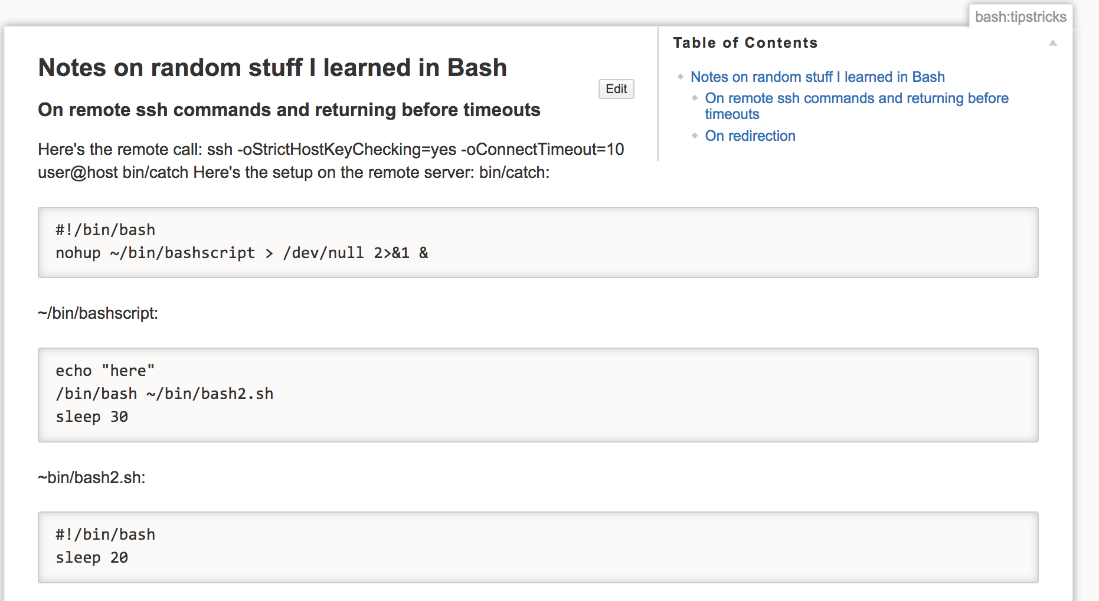
Data Management
Besides the README files (which ideally you should have in every directory), it helps to keep a lab notebook or a wiki so that you can share what you’ve done.

Slide 12
Data Management
I suggest doing all major steps of a project (for which you take inputs and produce outputs to be used downstream) inside of a shell script, and invoking the script:
nano runTrinity.sh Trinity –seqTypes…
bash runTrinity.sh

Slide 13
Data Management
You must have a long-term plan for your data!
Where will you keep the final results?
How often will you back up?
How will you fight the urge to hoard data?
What intermediates can you live without?

Slide 14
RNA-Seq with Trinity
FastQC is the best first step with raw fastq files!
fastqc /opt/datasets/Sp_ds.left.fq

Slide 15
RNA-Seq with Trinity
Run trimmomatic to clean up the reads, followed by FastQC.
java -Xmx15g -jar ~/Ark2017/Trimmomatic-0.36/trimmomatic-0.35.jar PE /opt/datasets/Sp_ds.left.fq /opt/datasets/Sp_ds.right.fq trimmed_ds_left.fq unpaired_trimmed_ds_left.fq trimmed_ds_right.fq unpaired_trimmed_ds_right.fq SLIDINGWINDOW:15:30 MINLEN:50

Slide 16
RNA-Seq with Trinity
Run Trinity using the reads you have cleaned.
Trinity --seqType fq --max_memory 12G -–left trimmed_ds_left.fq,trimmed_hs_left.fq -–right trimmed_ds_right.fq,trimmed_hs_right.fq

Slide 17
What is Galaxy?
At its core, Galaxy is a web-based tool for analyzing data
It provides a set of tools that one can apply to the data
It provides a trail of analyses one has run
It allows for sharing of data sets, methods, and workflows
Notes:
What is it? -> go over user interface. Where? Diff between local and remote.
While initially designed as a bioinformatics tool, at its core it is just a skin for any tools that one can think to connect to it.
Main instance runs on its own machine, but galaxy can be copied anywhere to run specialized tools.

Slide 18
What is Galaxy?
Galaxy was originally conceived as a tool to allow biologists to get work done without the need for training as an informatician
Galaxy’s purpose depends greatly on the tools made available to the user – these could be any command-line available software
Notes:
What is it? -> go over user interface. Where? Diff between local and remote.
While initially designed as a bioinformatics tool, at its core it is just a skin for any tools that one can think to connect to it.
Main instance runs on its own machine, but galaxy can be copied anywhere to run specialized tools.

Slide 19
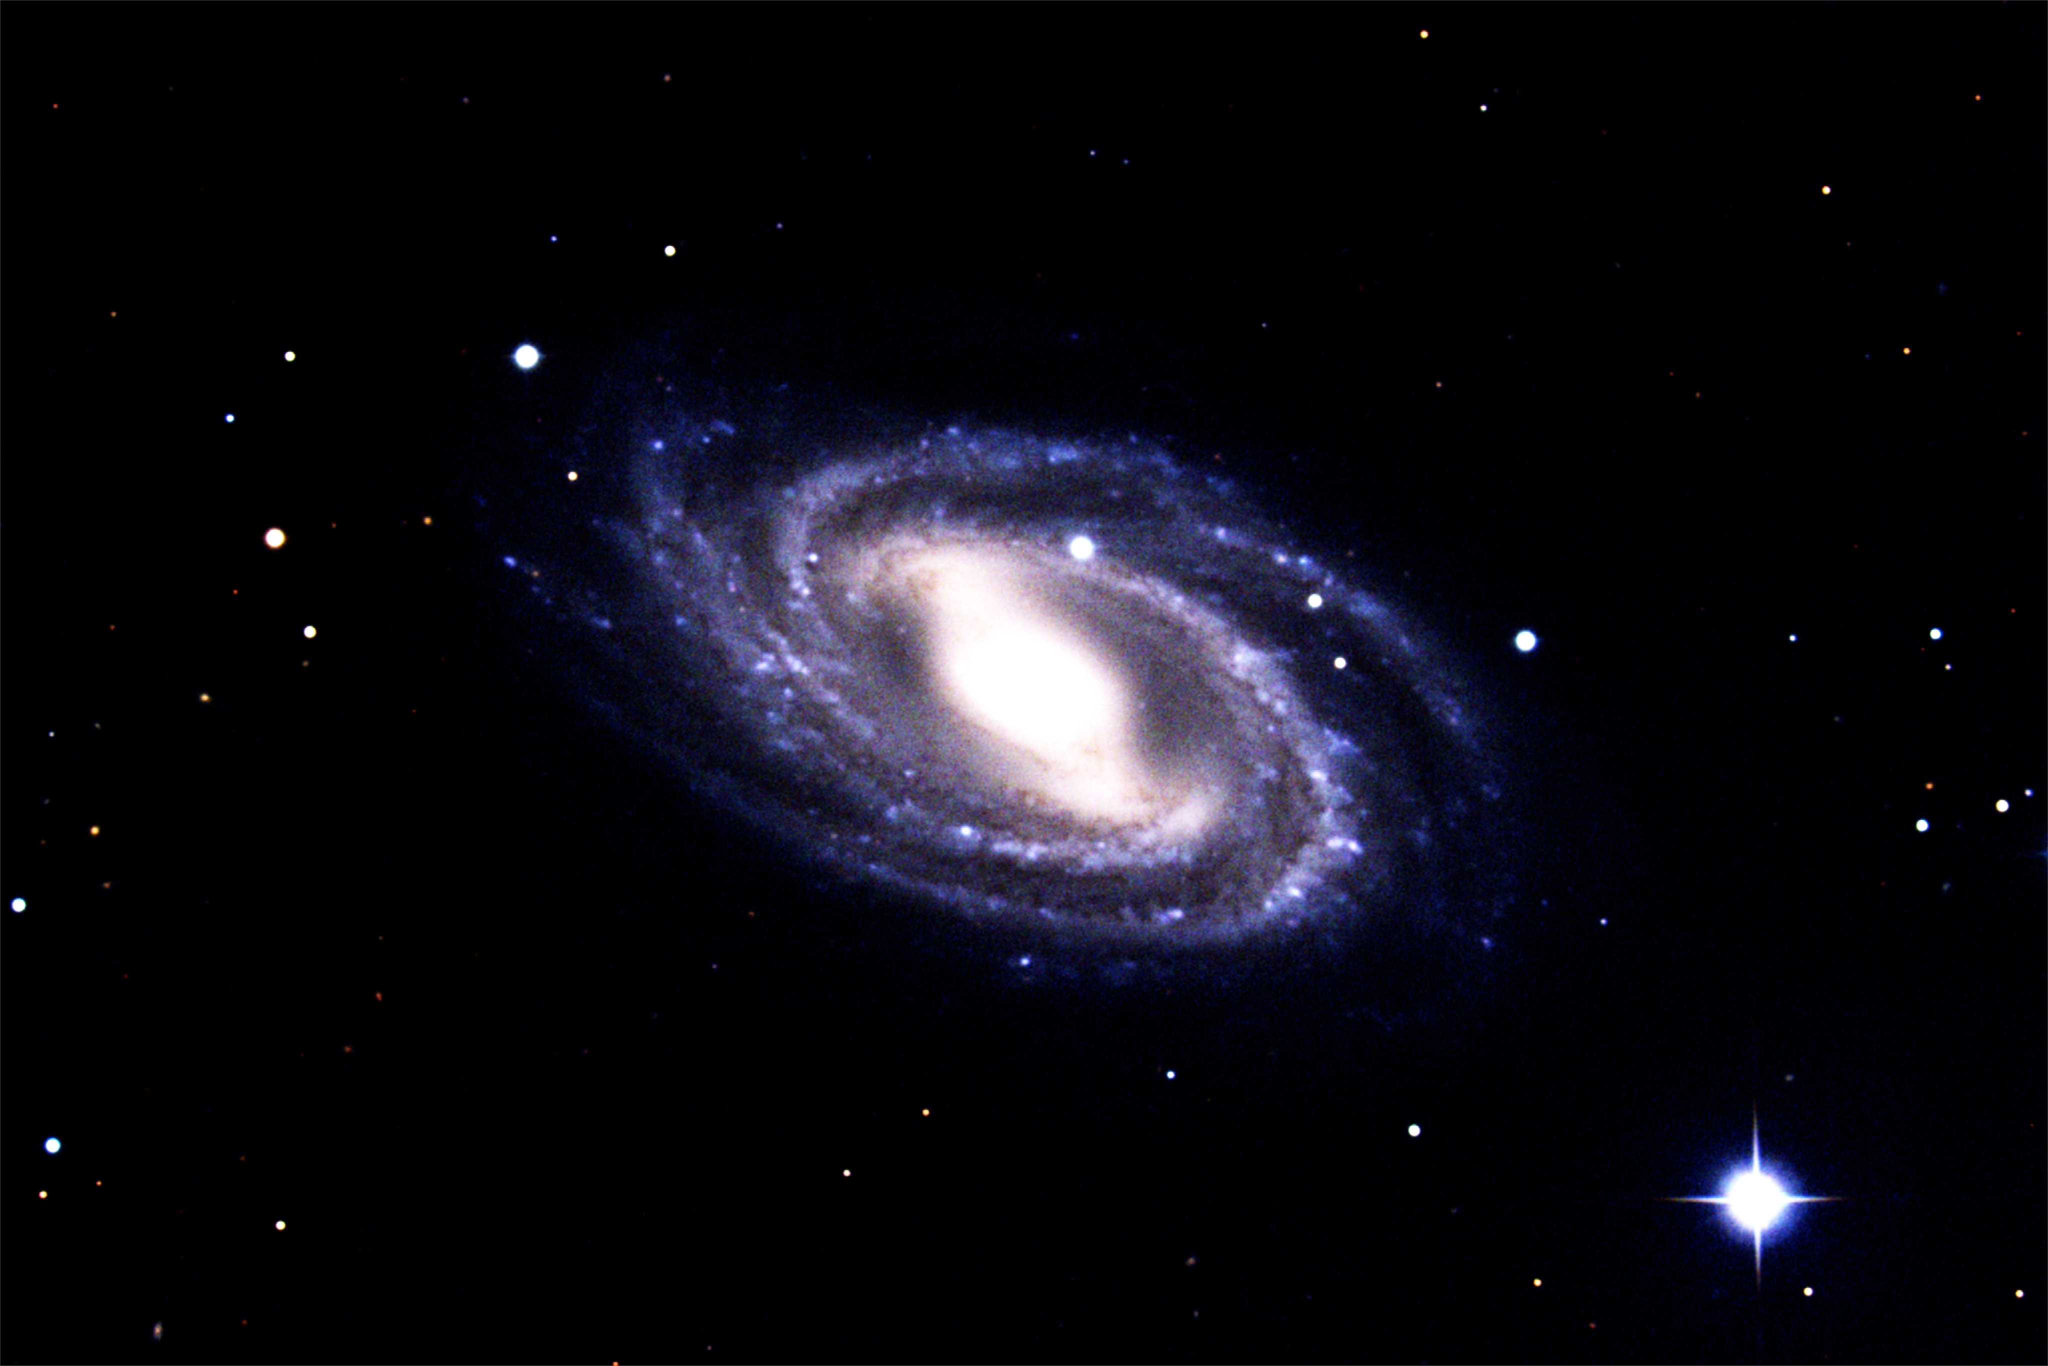



There are many Galaxies in the Universe!
Galaxy Main – hosted at Texas Advanced Computing Center
Galaxy-P – Proteomics-focused, hosted at U of Minnesota
Each is autonomous and specialized
Photo of M109 spiral galaxy courtesy of NOAO/AURA/NSF
Notes:
What is it? -> go over user interface. Where? Diff between local and remote.
While initially designed as a bioinformatics tool, at its core it is just a skin for any tools that one can think to connect to it.
Main instance runs on its own machine, but galaxy can be copied anywhere to run specialized tools.

Slide 20
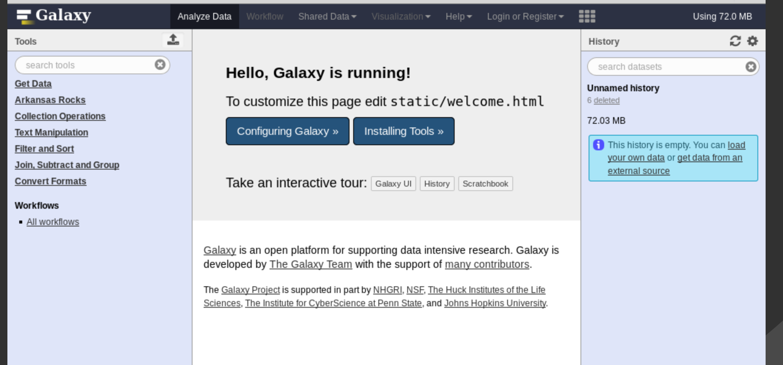
Galaxy Anatomy and Physiology
Tool bar – contains the available steps to apply to data
History – shows steps previously taken to manipulate input data sets
Focus pane – shows options, parameters, and output for current item.
Notes:
What is it? -> go over user interface. Where? Diff between local and remote.

Slide 21
Galaxy – the perfect technology?
There is no such thing as a perfect technology, but Galaxy might be good for you if you –
Don’t like looking up parameters/reading man pages
Don’t like managing job submissions/scripts
Want an automatic trail of data analysis steps
Like pastel colored web interfaces
Notes:
What is it? -> go over user interface. Where? Diff between local and remote.

Slide 22
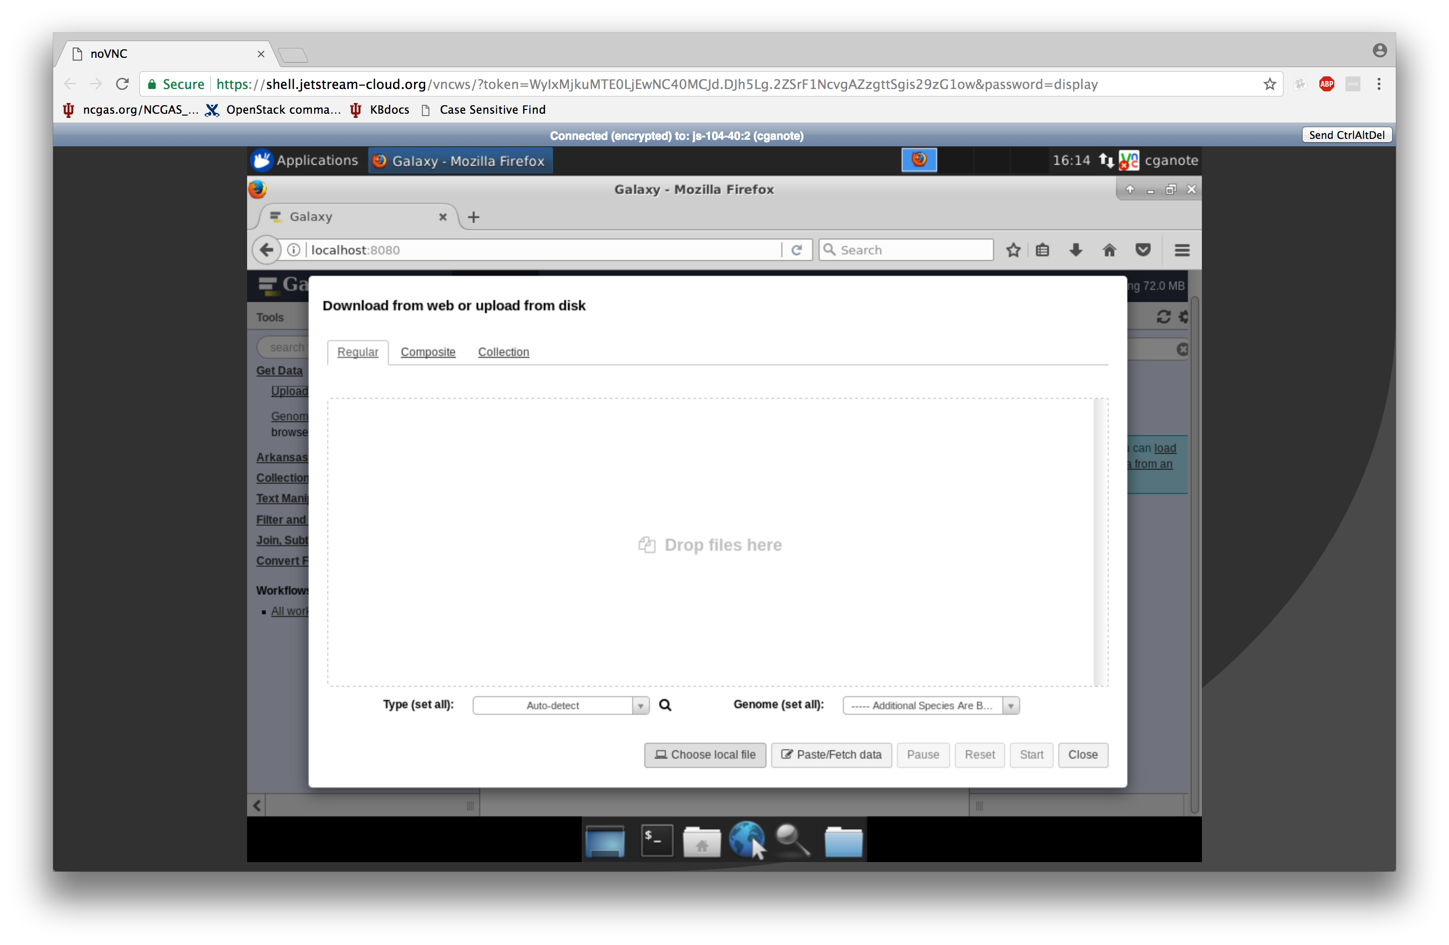
Step 1: Getting data
Notes:
Partial proteins vs. whole

Slide 23
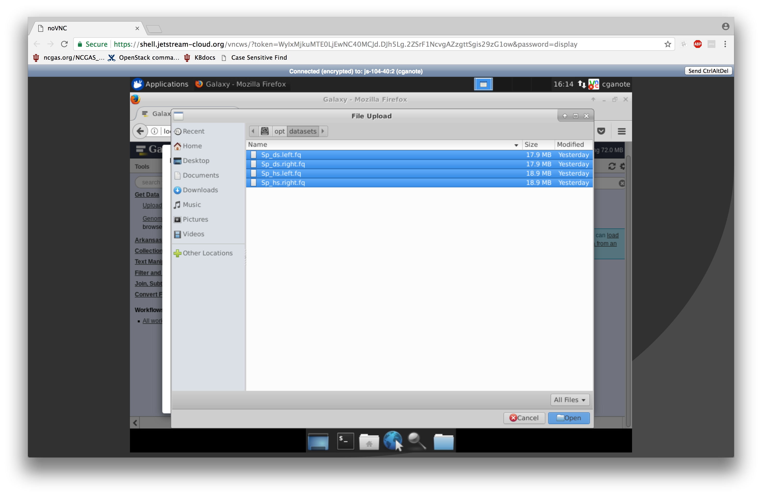
Step 1: Getting data
Click on the disk icon at the top left to find /opt.
Use shift or ctrl to select multiples at a time.
Notes:
Partial proteins vs. whole

Slide 24
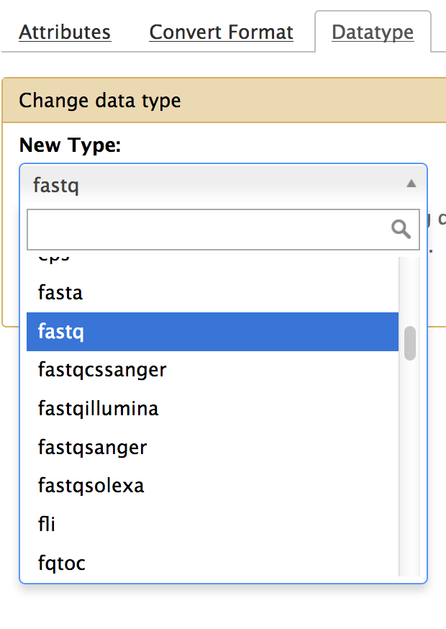
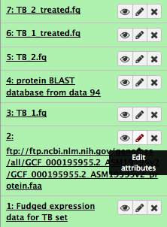
A little housekeeping
Edit attributes to change names or change the official type..
Change the datasets to be of type fastqsanger (and not fastqcsanger)

Slide 25
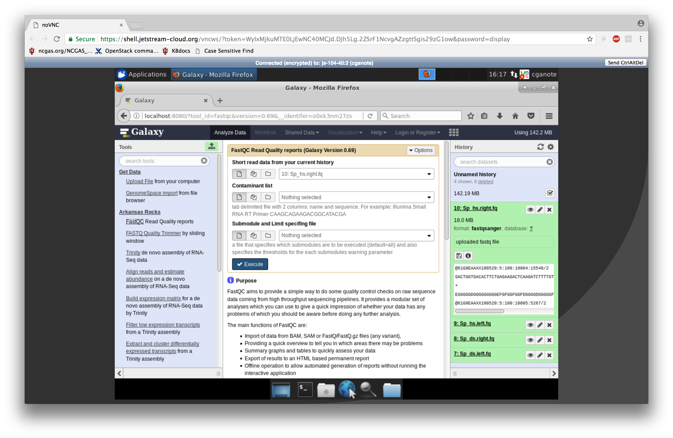
Step 2: Assess data
Notes:
Partial proteins vs. whole

Slide 26
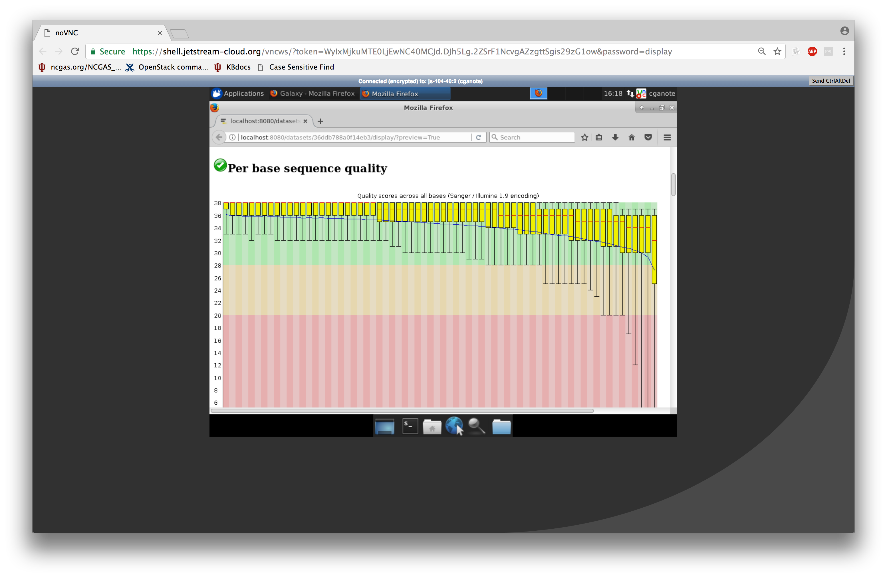
Step 2: Assess data
Notes:
Partial proteins vs. whole

Slide 27
Step 3: Trim
Choose the trimmer by sliding window, and use the following params:
Window 15
Cutoff of 30
Notes:
Talk about adapters and poly-a tails

Slide 28
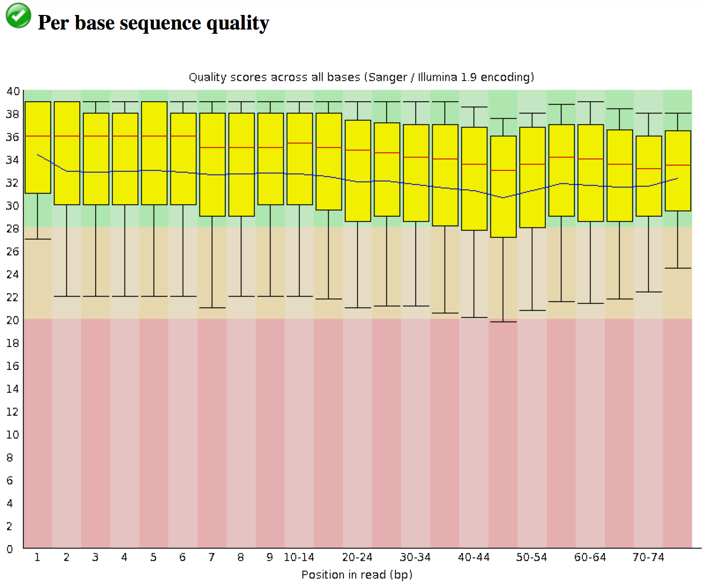
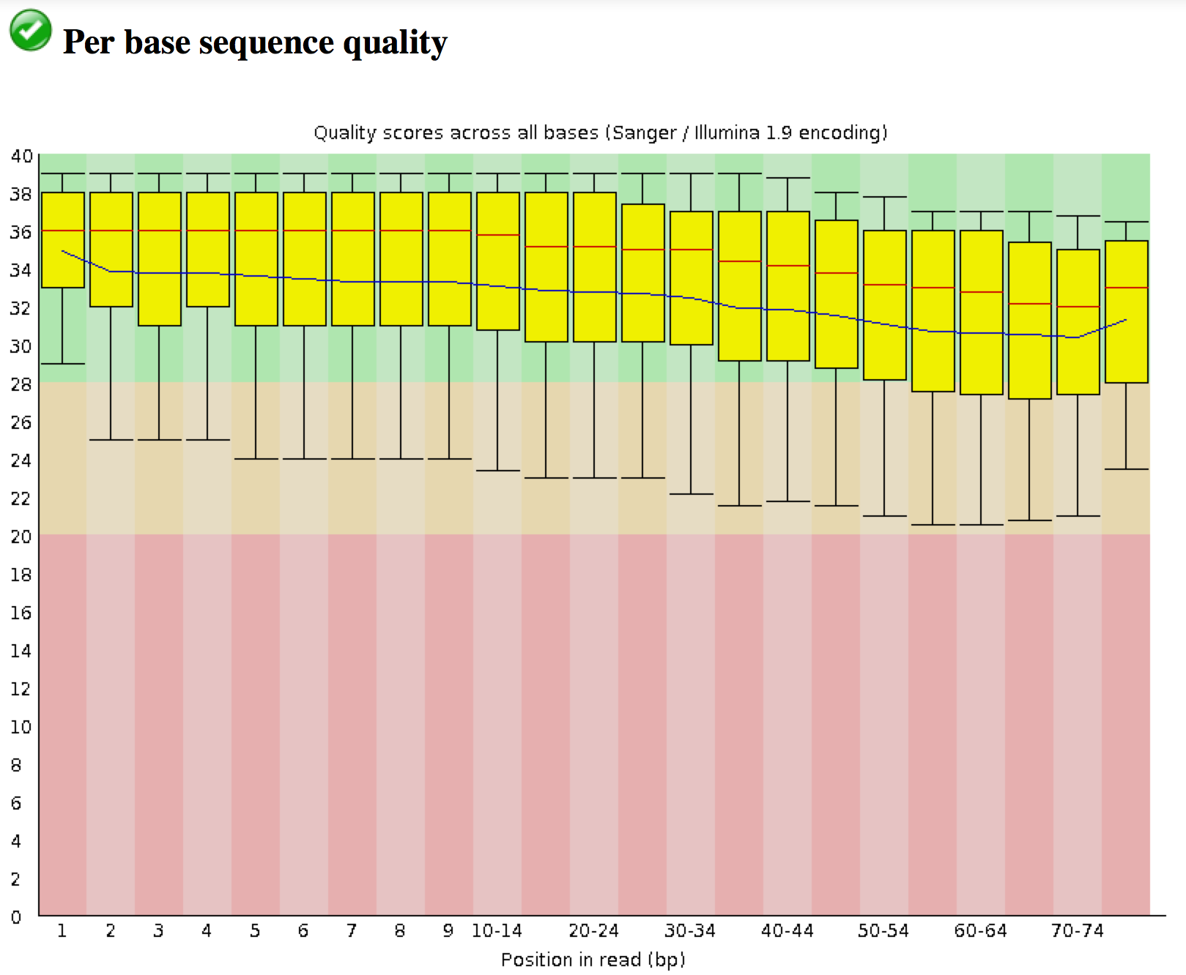
Step 3: Rinse, Repeat
Pictured are the left and right reads after trimming is complete.
These will do!
Notes:
Talk about adapters and poly-a tails

Slide 29
How to be an awesome bioinformatician
Google a lot
Don’t obsess about being an expert computer scientist; use what is comfortable for you
Check your results
Don’t Flail
Document what you do, not just what works!

